Slide 1

教学辅助课件
牛津 七年级下

Slide 2


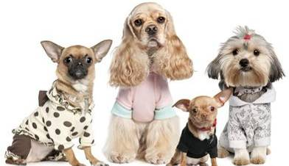
Unit 8 Pets
Task

Slide 3




Words review
paw
basket
noisy
n. (动物的)爪
n. 篮子
adj. 吵闹的，嘈杂的

Slide 4

Objectives
To be able to write a script about your favourite pet
To learn some key words and useful expressions: basket, noisy, paw play with a ball give her clean water
She never worries because we take good care of her.

Slide 5

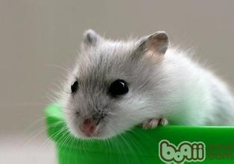
Guessing game:
Many people ____ me.
I like eating ____.
____are my enemies.
hate
rice
Cats
Mouse

Slide 6

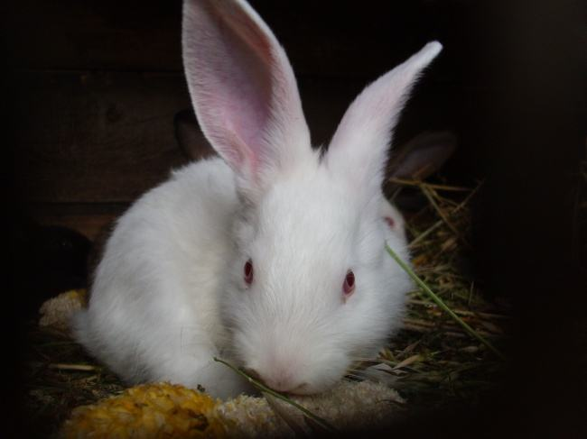
Guessing game:
run
I ____ quickly.
I have long ____ and short ____ .
I have red ____.
I like to eat ______.
ears
tail
eyes
carrots
Rabbit

Slide 7

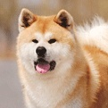
Guessing game:
I have four ____.
I’m very smart and I like to play.
I like to smell things.
I can wag (摇摆) my ____.
I can protect my master’s home.
legs
tail
Dog

Slide 8

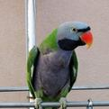
Guessing game:
I have a tail.
I can f___.
I have c______ feathers.
I can s____ and s_____.
ly
olorful
ing
peak
Parrot

Slide 9


Guessing game:
I can s____ very well.
I can’t live without _____.
I sleep with my ____ open.
I am o_____ or r___.
wim
water
eyes
range
ed
Goldfish

Slide 10
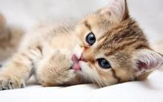
Guessing game:
legs
ail
I have four ____ and a long t___.
I have sharp t____ and claws.
I like to chase ____.
eeth
mice
Cat

Slide 11

long grey white
Appearance | She has ____, ____ fur and ____ paws. Her eyes are _____. She is quite _____ and weighs about ___ kilograms.
Personality | She is _______ and _____.
Lifestyle | She eats ____ ____, but she likes ____ best. She drinks _____ ____. She likes ________ in a basket and ______ with a ball. When she is ______, she will ______.
How does Amy look after Poppy? | Amy feeds her _____ ____ and gives her _____ _____, and _______ her fur sometimes.
Why does Amy like Poppy? | She is a good friend and never worries.
green
small
two
Amy gave a presentation on her cat. Read her script on page 102 and complete the column.
A
friendly quiet
cat food
fish
warm milk
sleeping
playing
hungry
miaow
every day
clean water
brushes

Slide 12
Structure of Amy’s favourite pet
Introduction
name
age
Appearance
colour
eyes
weight
size
Main body
Personality
friendly
quiet
lazy
Lifestytle
food
living place
like/dislike
how to look after it
Conclusion
What is special about your pet?

Slide 13
What does it look like?
Size ____ Eyes ____
Colour ____ Body ____
2. It is ____. (clever/friendly/happy/kind
/lazy/noisy/quiet)
3. Think about its lifestyle.
What does it eat?
What kind of place does it live in?
What does it like/dislike?
How do you look after it?
4. What is special about your pet?
You want to give a presentation on your favourite pet. First, prepare a fact sheet about it to help you organize your ideas.
(P 103)
B

Slide 14
Write your script for your presentation on your favourite pet. Use the information on the fact sheet in Part B. When you finish, present your work to the class. (P 103)
C
Useful expressions:
My favourite pet is …. His/Her name is ….
He/She is … years old.
My … looks like ….
He/She is always very friendly/quiet/happy /noisy.
Usually he/she eats ….
He/She lives in a cage/basket/box.
He/She likes / does not like ….
Why do you like your pet?

Slide 15
Sample writing:
My pet’s name is Pedro. He is a parrot. Pedro has red,
blue and yellow feathers and small, black eyes. He has a
large beak and a very long tail.
When I say hello to Pedro, he always tries to say hello
back. He is quite noisy sometimes, especially when he
is inside his cage.
Pedro likes to eat seeds and nuts. He eats a lot and
can be very messy. I have to feed Pedro every day and
clean his cage. I always give him fresh water and
sometimes a few grapes as a treat.
I like watching Pedro play with his toys. It is fun to talk
to him too. His favourite words are “hello” and
“lunchtime”. I think he is very funny. You can never
be sad with Pedro around.

Slide 16
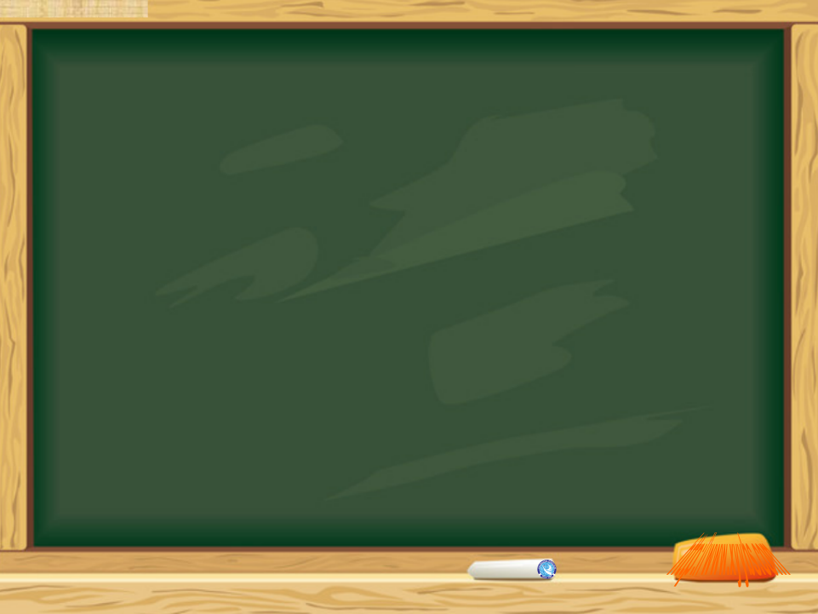


Homework
Finish the writing exercises in Learning English.

